Slide 1
Linear Algebra: Vector and Vector Operations in Data Science

Slide 2
Recommended books
Essential Math for Data Science
https://learning.oreilly.com/library/view/essential-math-for/9781098102920/
Practical Linear Algebra for Data Science
https://learning.oreilly.com/library/view/practical-linear-algebra/9781098120603/

Slide 3
Introduction to Linear Algebra
“Linear algebra concerns itself with linear systems but represents them through vector spaces and matrices.”
Linear Algebra applications in Data science
Machine Learning
Natural Language processing
Computer Vision

Slide 4
Matrix and Vector in Data Science
Vectors and Metrices are the most common and useful way of representing data that we want to analyze and manipulate for Machine Learning Algorithms in Data Science.

Slide 5
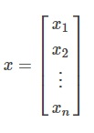
Linear Algebra: Vector
Vector is a tuple of one or, more values in one dimension (or, in 1D array).
A Vector with notation x ∈ R^{n} denotes, x is a vector with n entries and can be represented as,
The entries we expect in any Vector are continuous/discrete values that can be used for analytical purposes

Slide 6
Vector
Vector is a quantity with direction and magnitude, representing some data.
It is an arrow in space.
It is the building block of linear algebra.
It’s tail always starts at the origin of the cartesian plane (0,0)

Slide 7
Characteristics of vectors
2 most important characteristics of vectors are
Dimensionality: The number of numbers in the vector.
Orientation: Whether the vector is in column orientation (standing up tall) or row orientation (laying flat and wide).

Slide 8
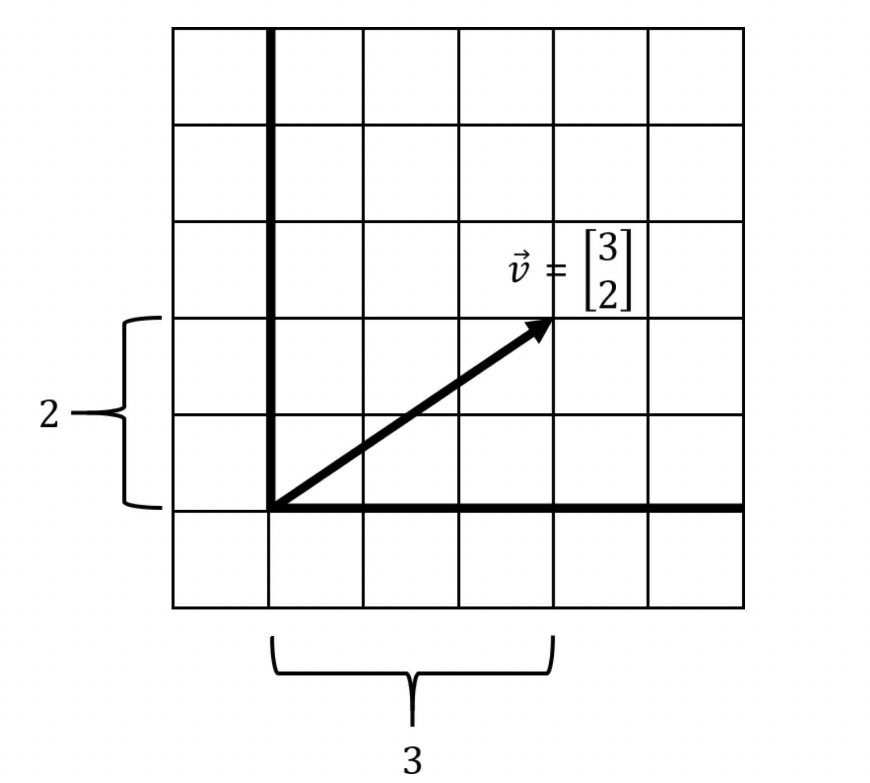
A simple vector

Slide 9
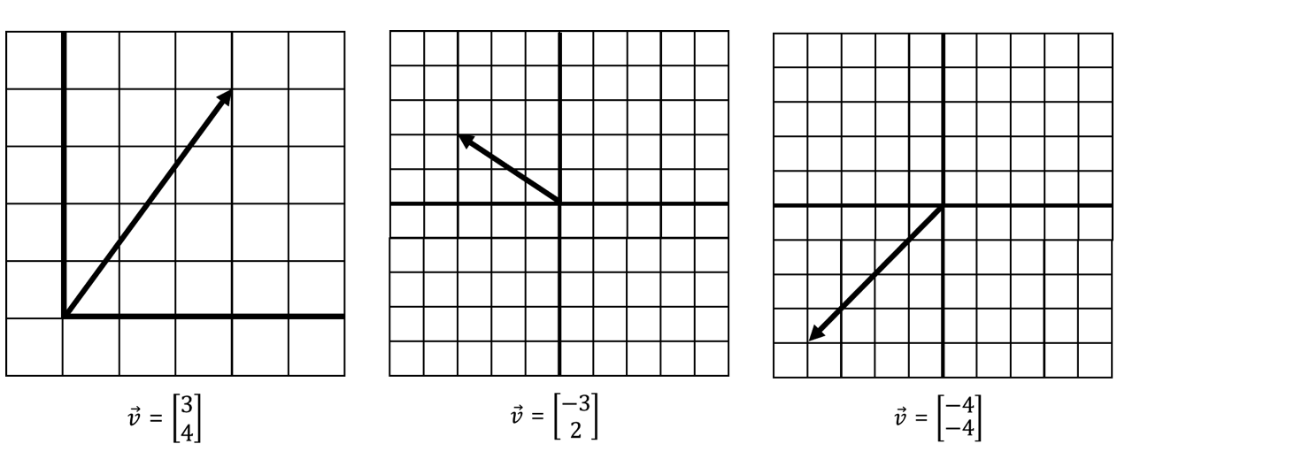
A sampling of different vectors

Slide 10
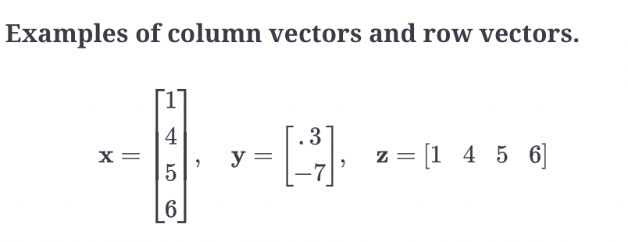

Slide 11
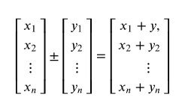
Vector Addition and properties
Vector Addition/Subtraction is the element wise addition/difference of two Vectors.

Slide 12
Vector addition
Two vectors can be added together only if they have the same dimensionality and the same orientation.

Slide 13
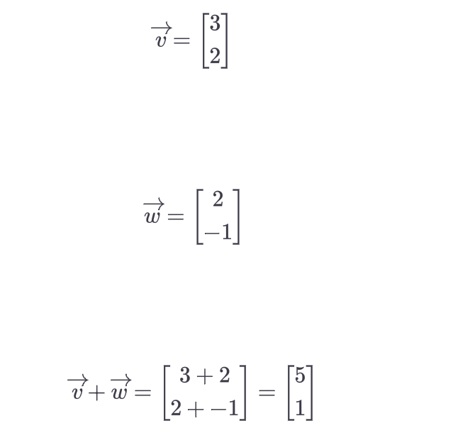
Vector Addition example

Slide 14
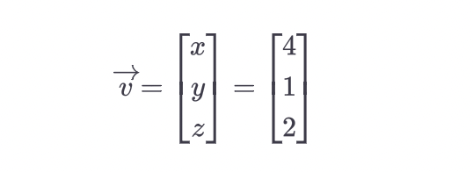
3 Dimensional vectors
Vectors can exist in more than 2 dimensions.
They are then represented through an array where the tuples are equal to the number of dimensions.
The following is an example of a 3-dimensional vector along the axes x, y and z.

Slide 15
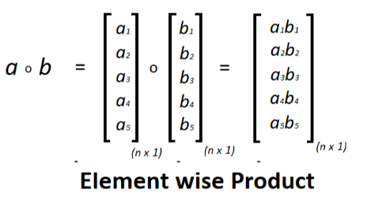
Hadamard Multiplication/Vector Multiplication
Vector Multiplication is the element wise product(s) and those products are represented as a new resultant vector.

Slide 16
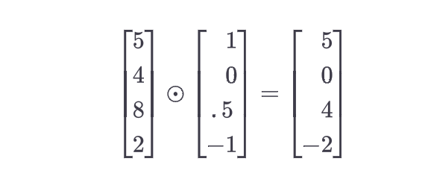
Example

Slide 17
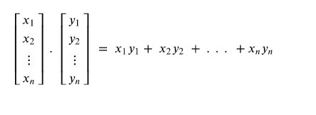
Vector Dot(.) product
Vector Dot product is the element wise product and addition of the product(s).

Slide 18
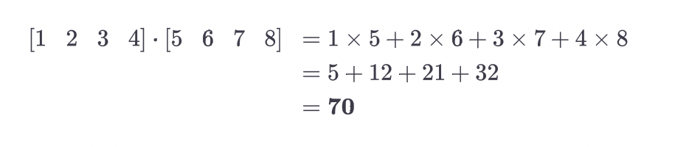
Example of Dot product

Slide 19
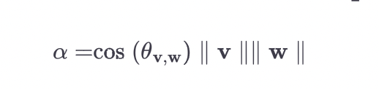
Geometric definition of the vector dot product

Slide 20
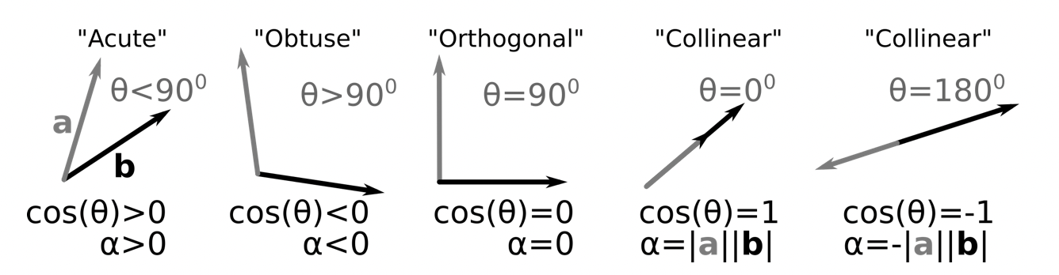
5 cases of the dot product sign

Slide 21
Dot product Example
Use vectors to decide whether the triangle with vertices P(2, -3, -1), Q(3, 0, -3), and R(7, -2, -4) is right-angled.
The dot product of two vectors is an operation resulting in a scalar equal to the product of the vector's absolute values multiplied by the cosine of the angle between them,
a⋅b=|a||b|cosθ.
As a result, the dot product is maximum if the vectors are parallel, minimum if they are antiparallel, and zero if they are orthogonal.

Slide 22
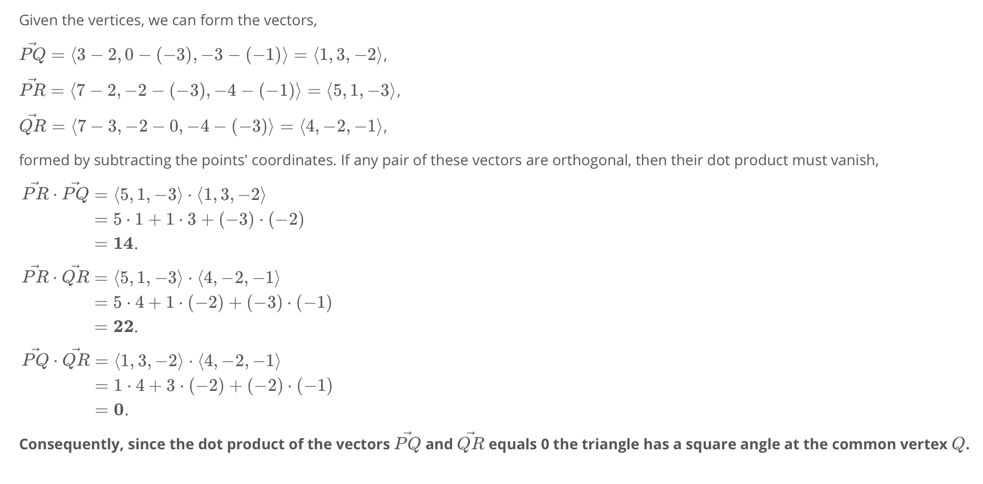
Solution

Slide 23
Scaling a vector
Scaling a vector is shrinking or growing a vector’s length.
You can grow/shrink a vector by multiplying or scaling it with a single value, known as a scalar.
We can combine two vectors and scale them to create any resulting vector we want.
vectors v and w, fixed in two different directions, can be scaled and added to create any new vector v+w.

Slide 24
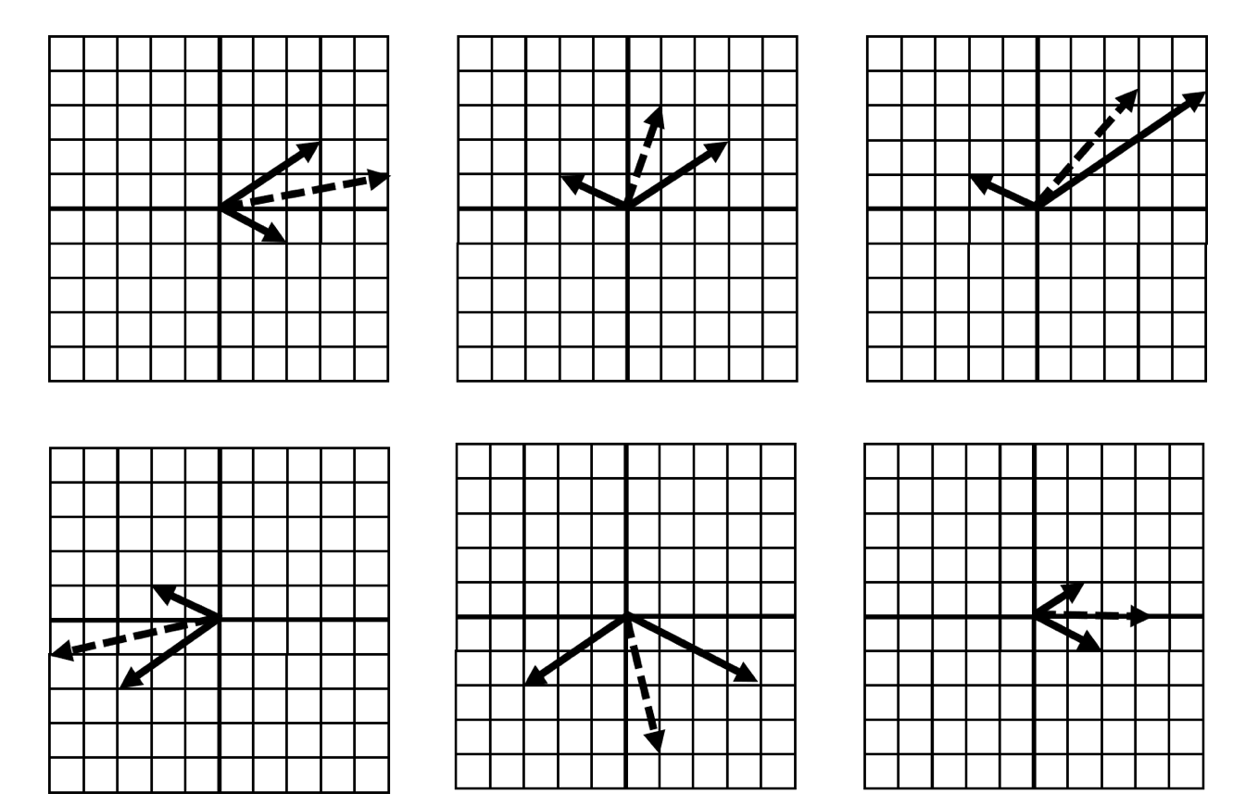

Slide 25
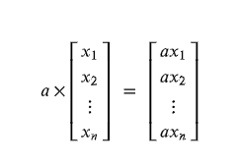
Scalar Multiplication of Vector
Scalar Multiplication is the element wise multiplication of a Scalar value (Scalar Value is given).

Slide 26
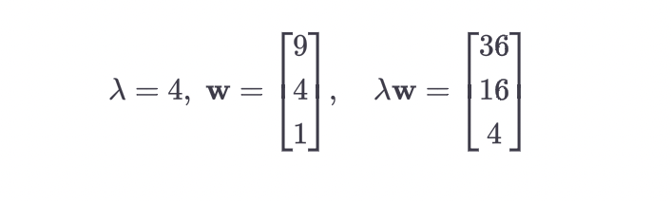
Example of Scaler multiplication

Slide 27
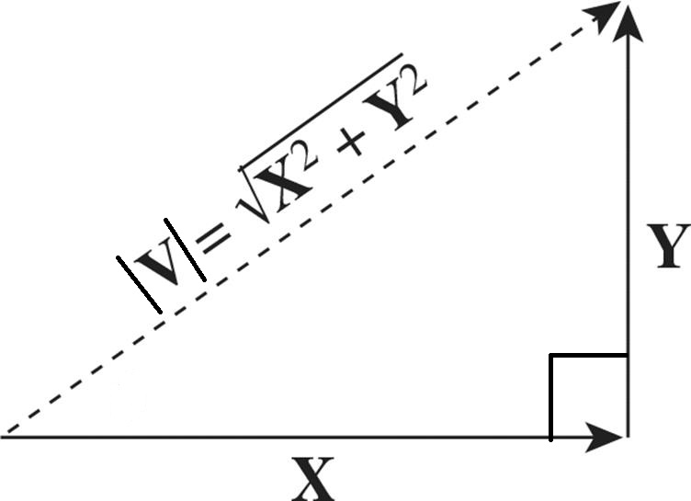
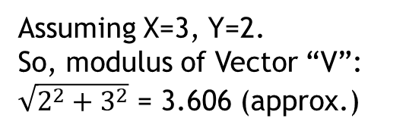
Modulus of Vector
The magnitude or, length of a Vector is called Modulus of that Vector, which is, the absolute value of the Vector.
The magnitude/modulus of a Vector “V” is expressed as,
Assuming X=3, Y=2. So, modulus of Vector “V”:
$\sqrt{2^{2}+3^{2}}$ = 3.606 (approx.)

Slide 28
Linear transformations
Linear transformation is when we use a vector to transform another vector in a function-like manner.

Slide 29
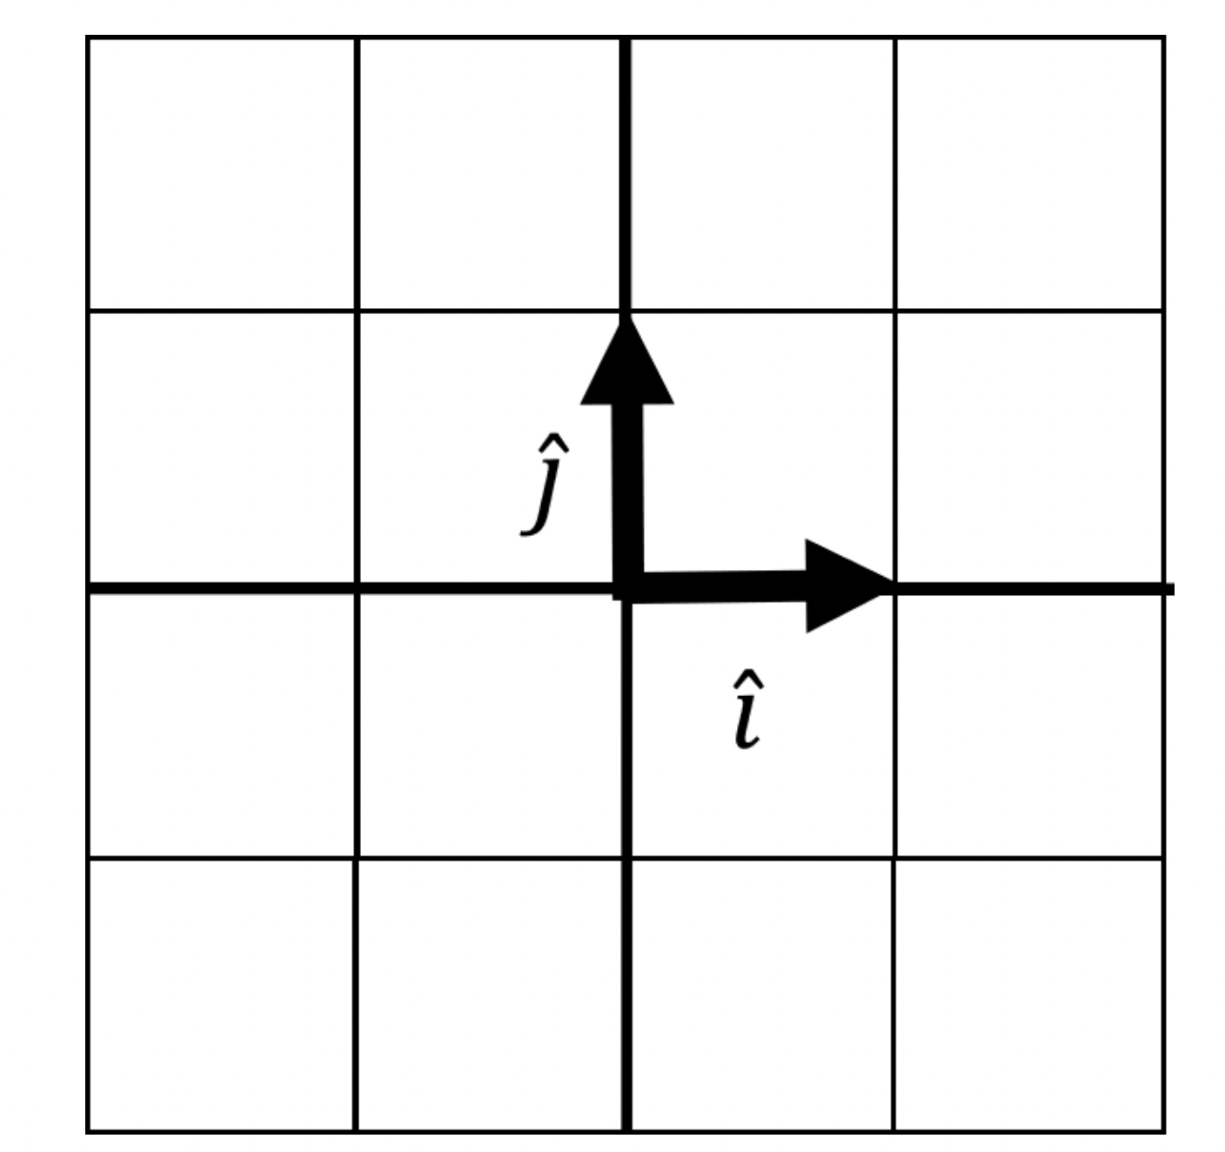
Basis Vectors
Imagine we have two simple vectors i^ and j^ (“i-hat” and “j-hat”). These are known as basis vectors, which are used to describe transformations on other vectors. They typically have a length of 1 and point in perpendicular positive directions.

Slide 30
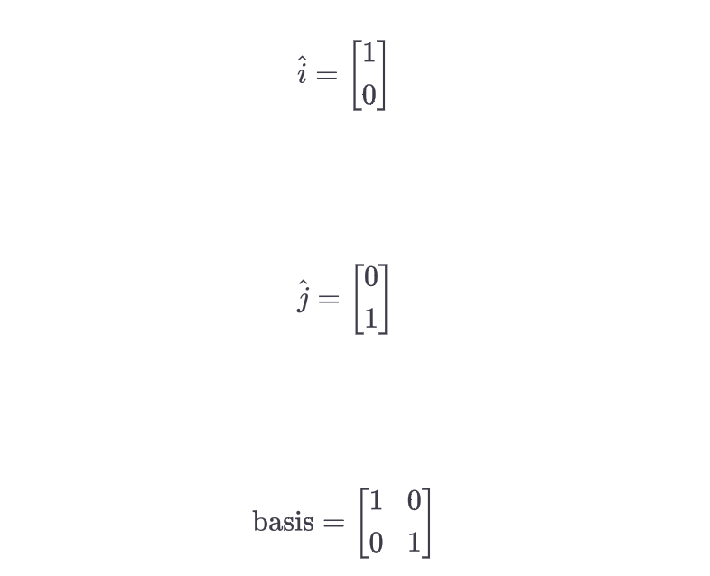
Basis Vectors
Basis vectors are the building blocks to transform any vector.
Our basis vector is expressed in a 2 × 2 matrix, where the first column is i^ and the second column is j^:

Slide 31
Linear transformations
A matrix is a collection of vectors (such as i^, j^) that can have multiple rows and columns and is a convenient way to package data. We can use i^ and j^ to create any vector we want by scaling and adding them.

Slide 32
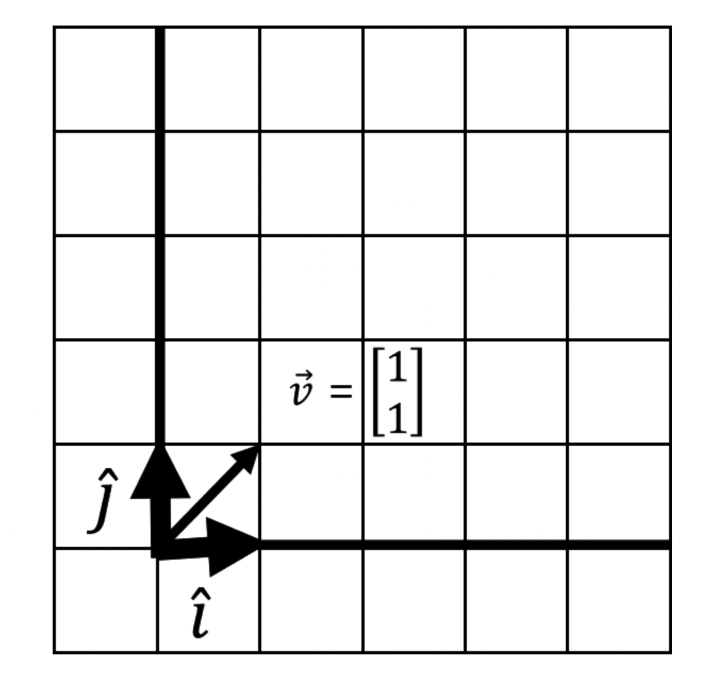
Creating a vector from Basis Vector

Slide 33
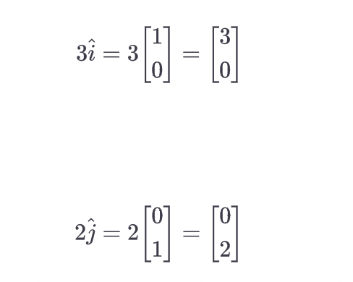
Example
We want a vector v to land at [3,2].
We stretch i by a factor of 3, and stretch j by a factor of 2.

Slide 34
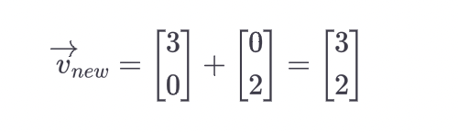
Then we add i and j

Slide 35
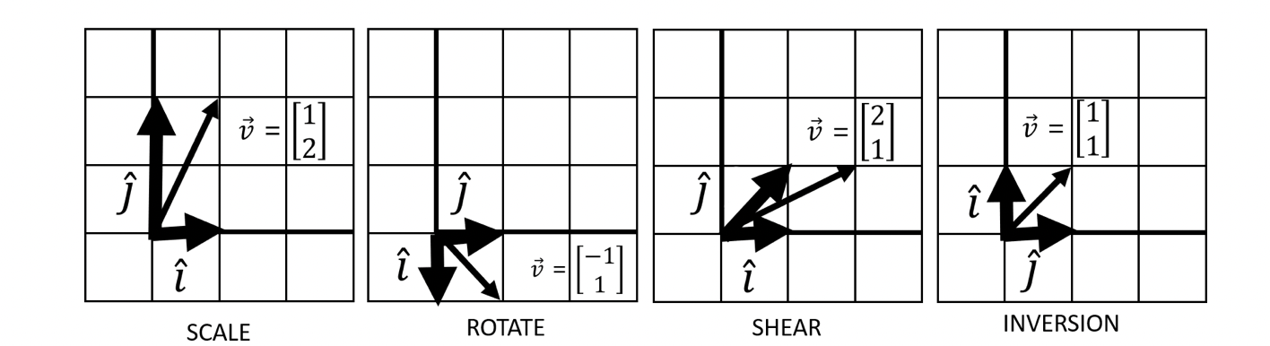
Linear Transformations
We can achieve 4 movements through linear transformations

Slide 36
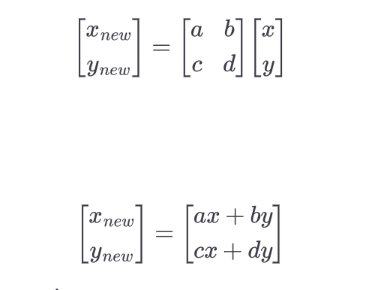
Matrix Vector Multiplication

Slide 37
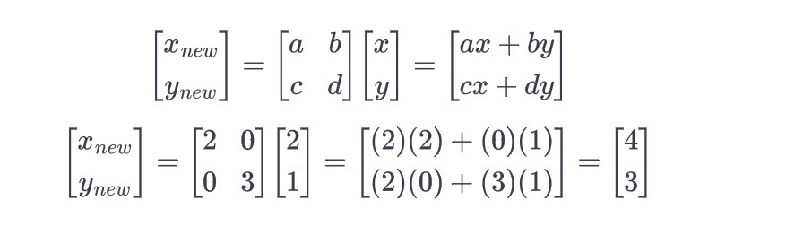
Example
Vector v being [2, 1] and i^ and j^ start at [1, 0] and [0, 1], respectively. We then transform i^ and j^ to [2, 0] and [0, 3]. What happens to vector v? Working this out mathematically by hand using our formula, we get this:

Slide 38
End

